Slide 1
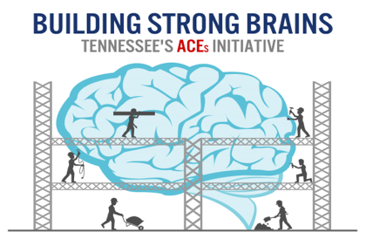
Building Strong Brains: The Role of Life Experiences in Shaping Brain Development
Dr. Freida Outlaw, PhD, RN, FAAN
Executive Academic/Program Consultant
Minority Fellowship Program
SUBSTANCE ABUSE AND MENTAL HEALTH SERVICES ADMINISTRATION
MINORITY FELLOWSHIP PROGRAM
AMERICAN NURSES ASSOCIATION

Slide 2
Tennessee’s ACEs Initiative Mission
Building Strong Brains: Tennessee’s ACEs Initiative
We work to change the culture of Tennessee so that the state’s overarching early childhood philosophy, policies, programs and practices utilize the latest brain science to prevent and mitigate the impact of adverse childhood experiences.

Slide 3

Strong Communities
Healthy Economy
Successful Parenting of Next Generation
Educational Achievement
Economic Productivity
Responsible Citizenship
Lifelong Health
Healthy Child Development

Slide 4
Four Core Concepts of Development
1
Brain Architecture Is Established Early in Life and Supports Lifelong Learning, Behavior, and Health
2
Stable, Caring Relationships and “Serve and Return” Interaction Shape Brain Architecture
3
Toxic Stress in the Early Years of Life Can Derail Healthy Development
4
Resilience can be Built through “Serve and Return” Relationships, improving Self-Regulation, and Executive Functions.

Slide 5
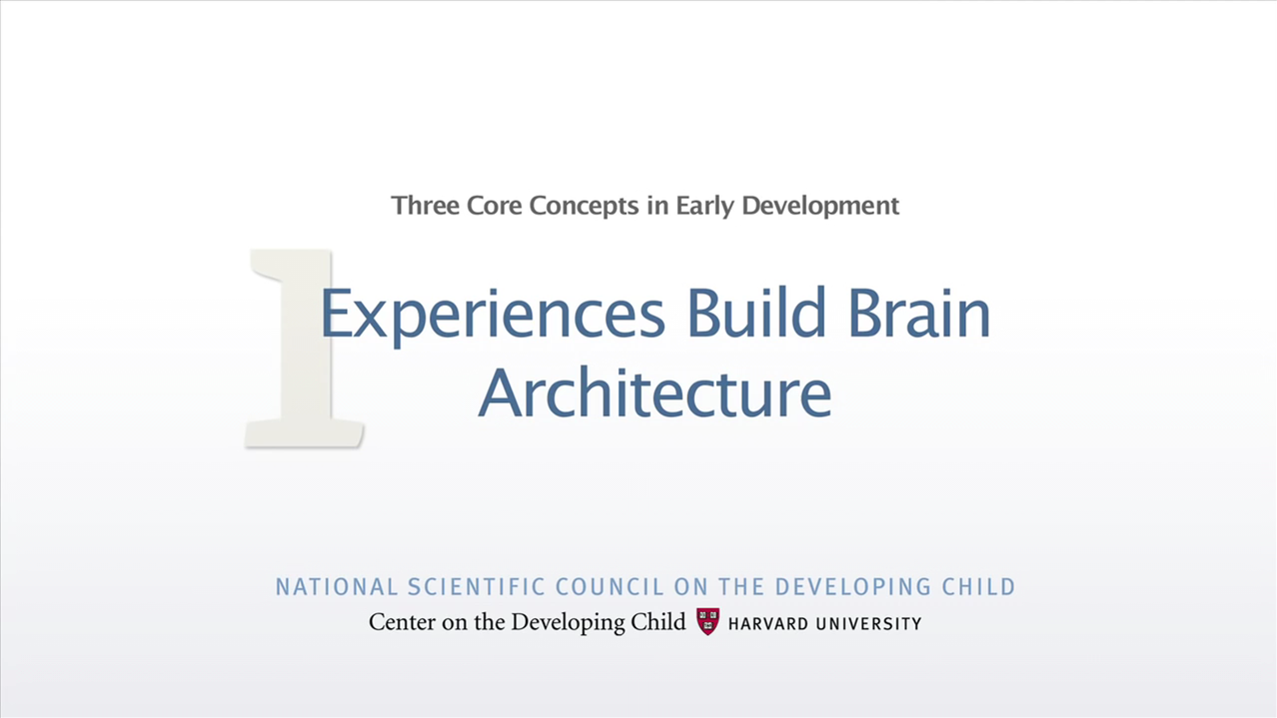
http://developingchild.harvard.edu/resources/experiences-build-brain-architecture/
Notes:
http://developingchild.harvard.edu/resources/experiences-build-brain-architecture/ - 1 min 57 sec

Slide 6
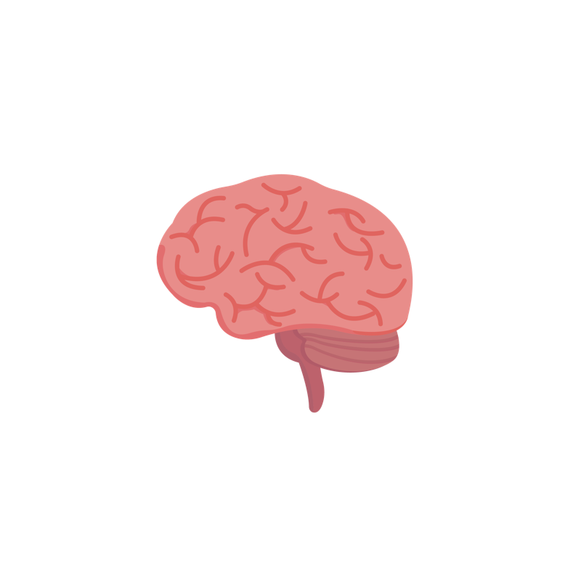
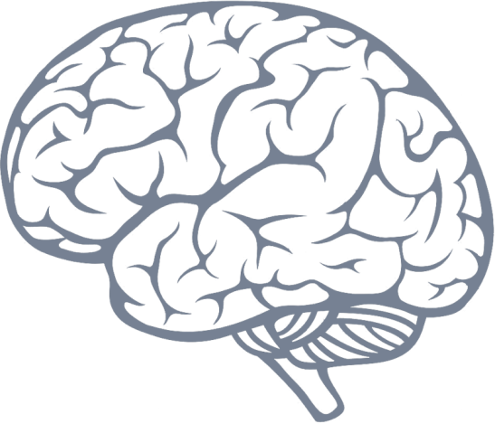
Brain Architecture Supports Lifelong Learning, Behavior, and Health
Motor Skills
Language
Behavioral
Control
Memory
Emotion
Visual
Brains are built over time, starting in the earliest years of life. Simple skills come first; more complex skills build on top of them.
Cognitive, emotional, and social capabilities are inextricably intertwined throughout the life course.
A strong foundation in the early years improves the odds for positive outcomes and a weak foundation increases the odds of later difficulties.

Slide 7
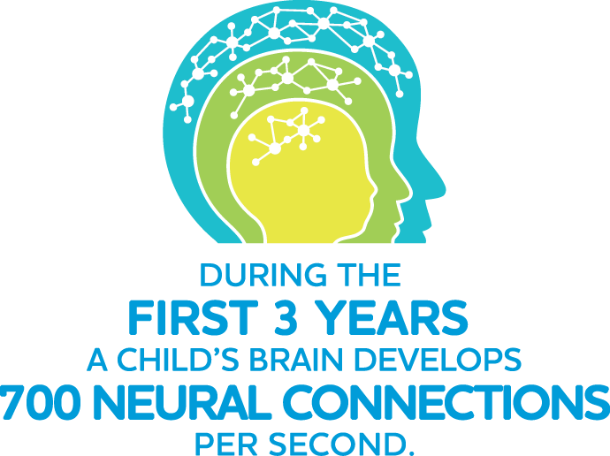
Notes:
In the first few years of life, 700 to 1,000 new neural connections form every second which means every second counts for brain development.

Slide 8

Serve & Return Relationships Support Skill Learning

Slide 9
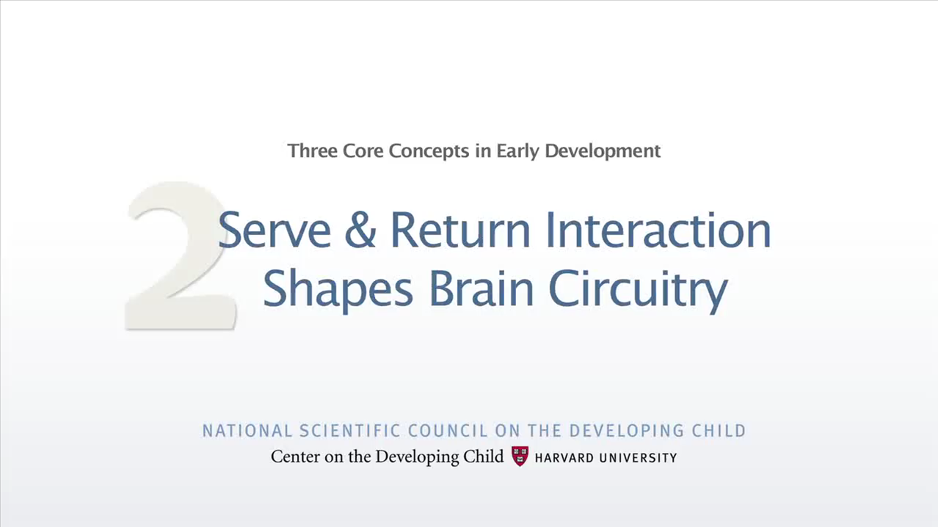
http://developingchild.harvard.edu/resources/serve-return-interaction-shapes-brain-circuitry/
Notes:
http://developingchild.harvard.edu/resources/serve-return-interaction-shapes-brain-circuitry/ - 1 min 42 sec

Slide 10

Serve & Return Interactions Build
Brains and Skills
Young children naturally reach out for interaction through babbling, facial expressions, and gestures, and adults respond in kind.
These “serve and return" interactions are essential for the development of healthy brain circuits.
Therefore, systems that support the quality of relationships in early care settings, communities, and homes also support the development of sturdy brain architecture.

Slide 11
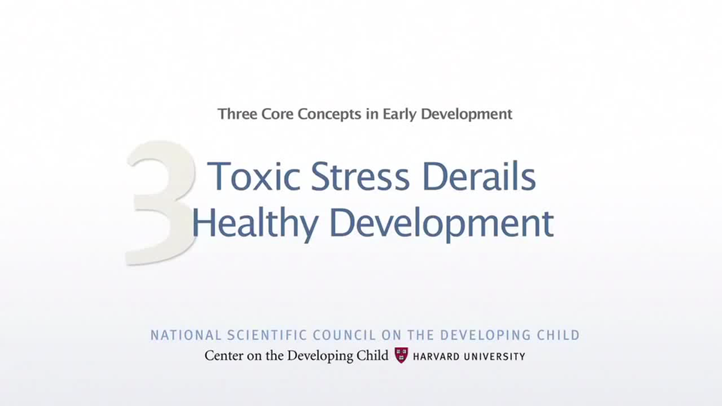
http://developingchild.harvard.edu/resources/toxic-stress-derails-healthy-development/
Notes:
http://developingchild.harvard.edu/resources/toxic-stress-derails-healthy-development/ - 1 min 52 sec

Slide 12
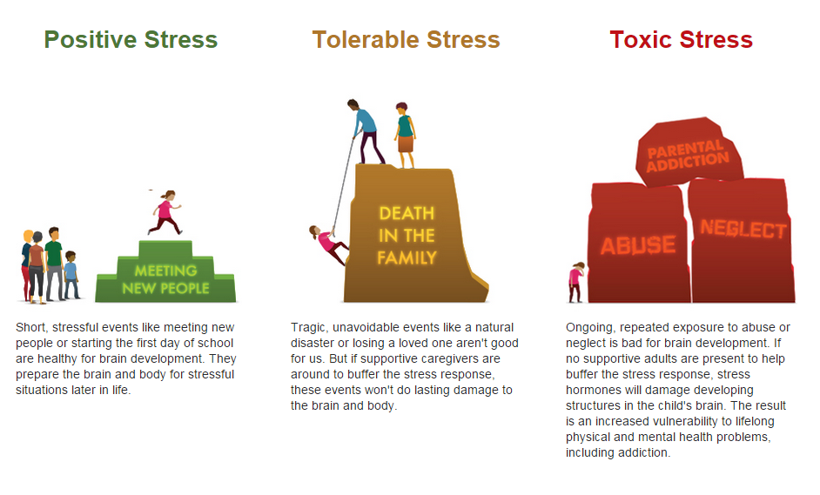
Notes:
KEEP

Slide 13
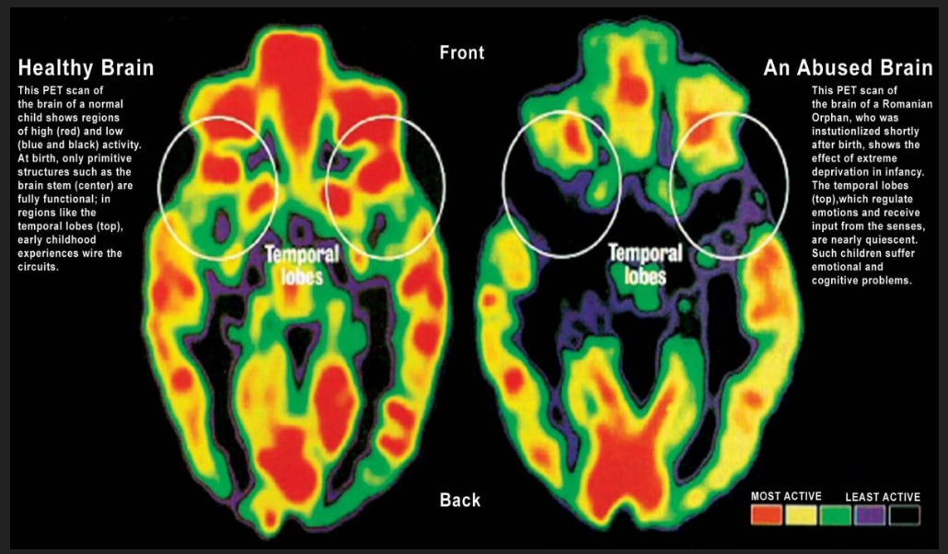
Experience Alters Brain Development
Normal vs. Neglected Brain
Notes:
CONTENT NEEDED HERE
As cited by Felitti & Anda, 2003; source CDC

Slide 14
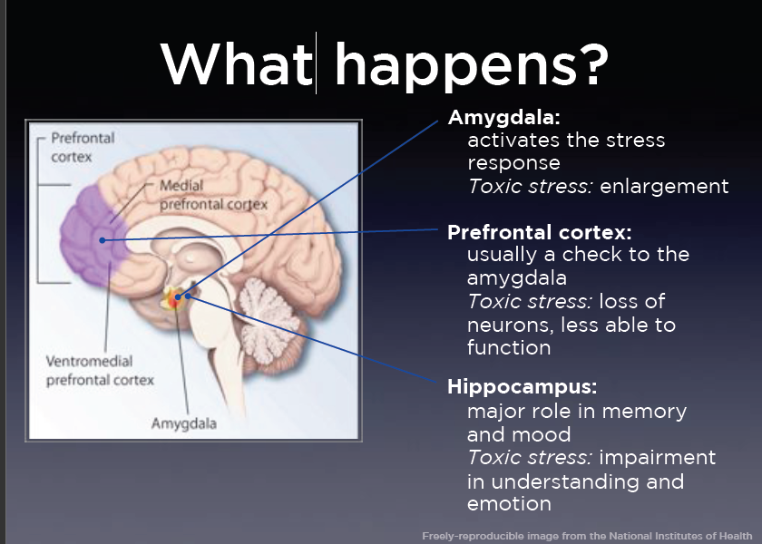
Notes:
KEEP BRAIN and REDESIGN

Slide 15
Toxic Stress Impacts
1
Brain Architecture
2
Biology and Physiology
3
Gene Expression and Epigenetics

Slide 16

How Brains are Built
Notes:
http://www.albertafamilywellness.org/resources/video/how-brains-are-built-core-story-brain-development - 4 min 5 sec

Slide 17
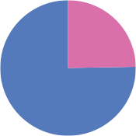
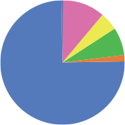
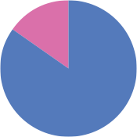
ACE Study Demographics
Participants were mostly white, middle-aged, college educated, and insured. They didn’t face many of life’s challenges such as poverty or racism.
11.2%
4.6%
15.1%
24.8%
7.2%
1.9%
75.2%
74.8%
84.9%
At least some college
White
Ages 40+
No college
Hispanic
Ages 19-39
Black
Asian
Other
Source: Centers for Disease Control and Prevention, Available at: https://www.cdc.gov/ace/about.htm

Slide 18
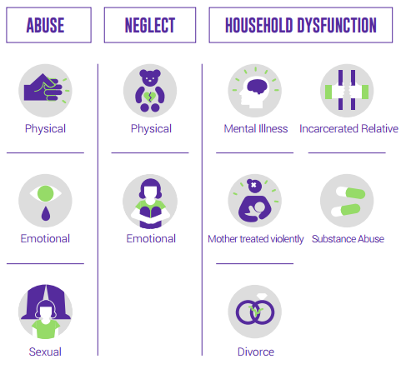
Adverse Childhood Experiences
Notes:
REDESIGN

Slide 19
What Are Adverse Childhood Experiences (ACEs)?
Are there “new” ACEs? YES!!
  Poverty
  Racism
  Peer Victimization, i.e., Bullying
These are referred to as conditions of Trauma and Social Location
  Race/ Social Conditions/Local Context
  Generational Embodiment/Historical Trauma
Notes:
REDESIGN?

Slide 20
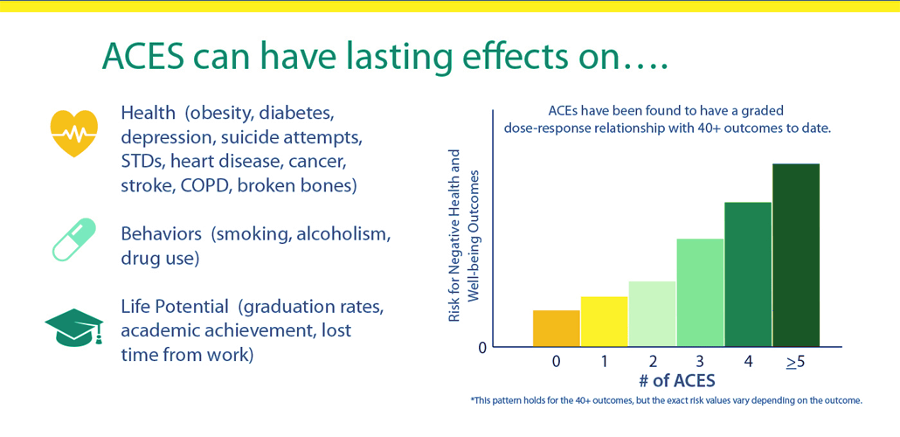
Notes:
As your ACE Score increased, so did your risk for health risk behaviors, disease, social problems, and mental health issues.
ACEs have been found to have a graded dose-response relationship with 40+ negative outcomes to date
http://www.cdc.gov/violenceprevention/acestudy/about_ace.html

Slide 21
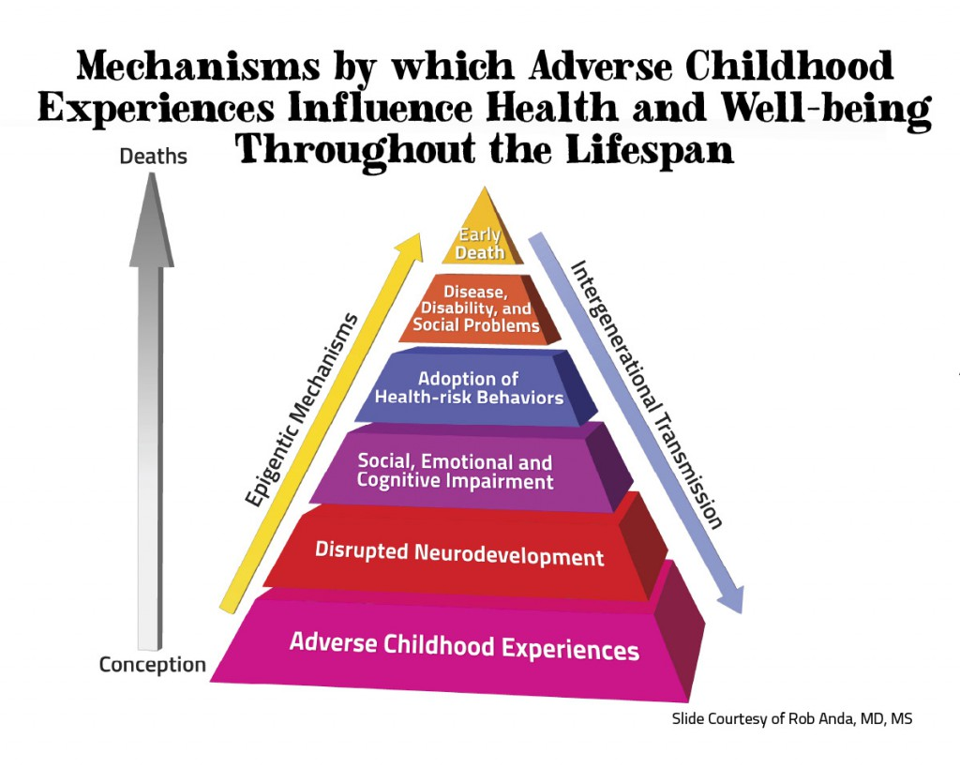
Mechanisms by which Adverse Childhood Experiences Influence Health and Well-being Throughout the Lifespan
Notes:
REDESIGN
www.communityresiliencecookbook.org

Slide 22
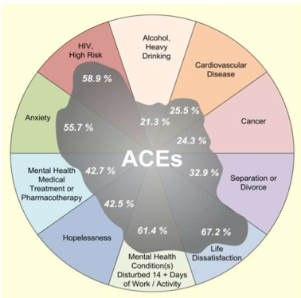
Magnitude of the Solution
Notes:
REDESIGN/RECONCEPTUALIZE
Although we’ve talked a great deal about the impact of ACEs on individuals, we know their collective affect creates a massive public health issue. This image demonstrates how much ACEs contribute to leading disease, emotional and mental health.
The “oil spill” in each part of the pie piece is the amount of that issue that is attributable to ACEs. If you imaged reducing ACEs as placing a paper towel in the middle and soaking it up, you would see simultaneous and relative reduction in every single one of these problem areas.
Even if you don’t have an ACE score, ACEs impact you by compromising your community, safety, and tax dollars. High ACE scores compromise prosperity for us all.
IMPACT IN HEALTHCARE COSTS THAT IS RELATIONAL
http://www.aceresponse.org/give_your_support/Washington_State_Family_Policy_Council_19_52_sb.htm

Slide 23
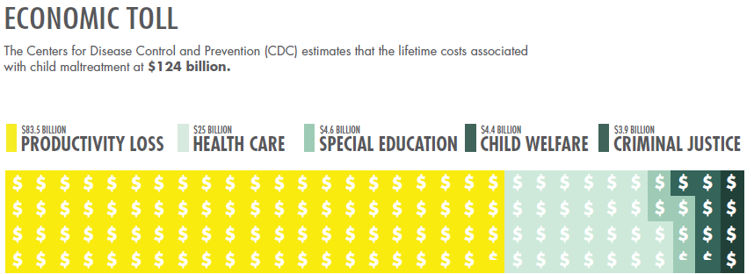
The Cost of ACEs
Notes:
Graphic from the CDC. Greatest economic toll is actually productivity loss. Absence from the work force, missed days from work due to sickness or mental health issues. Think about the impact that has on businesses in Tennessee.
http://vetoviolence.cdc.gov/index.php/infographic-adverse-childhood-experiences-3/

Slide 24
ACEs in Tennessee
61% had at least 1 ACE
24% had 3 or more ACEs (that’s 1 in 4)
Source: Tennessee Behavioral Risk Factor Surveillance System (BRFSS), 2012.
Notes:
Adverse Childhood Experiences in Tennessee, Lucinski, L; (2015), Retrieved from: https://tn.gov/health/topic/MCH-reports

Slide 25

Fostering Resilience
https://vimeo.com/106322359

Slide 26
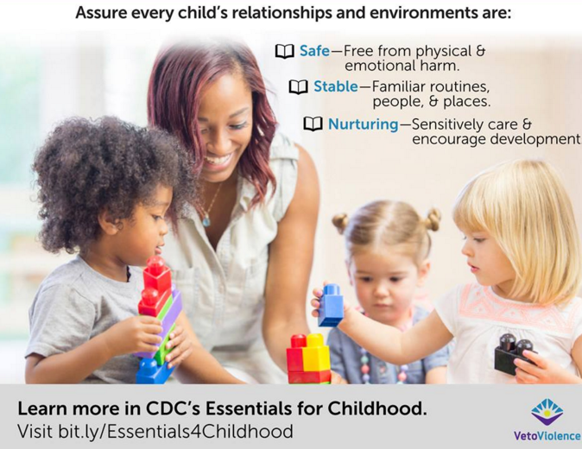
Notes:
Research indicates that supportive, responsive relationships with caring adults as early in life as possible can prevent or reverse the damaging effects of toxic stress response.
The CDC recommends safe, stable and nurturing relationships and environments to protect children from accumulating ACEs and to mitigate them.

Slide 27

Collective Ingenuity

Slide 28
The Biology of Adversity Suggests a New Theory of Change to Enhance Both Learning and Health
    Because excessive activation of the body’s stress response systems can lead to long-term disruptions in brain architecture, immune status, metabolic regulation, and cardiovascular function …
Reduce the number and severity of adverse experiences for young children
Strengthening relationships that protect young children from the harmful effects of toxic stress
Requires attention to infrastructure of social and health services to both parents and children
Also requires focusing on parents’ needs as much as children

Slide 29
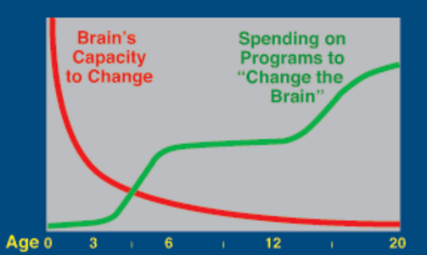
Moving the Needle
    Focus has to shift from remediation to prevention and not just “prevention,” but primary prevention
Age 0 I 3 I 6 I 12 I 20

Slide 30
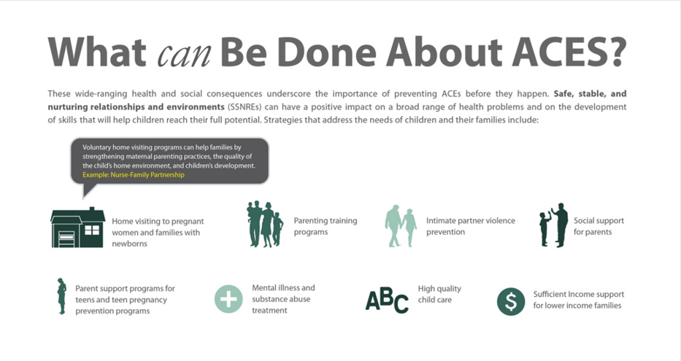
Notes:
REDESIGN…LESS TEXT AND BIGGER IMAGES…PERHAPS HAVE IMAGES ON MULTIPLE SLIDES SO PEOPLE CAN READ THEM
When we think about programs and services that can reduce ACEs, we can think about those services that support parents to provide safe stable and nurturing relationships.
Walk through each service listed.
Communities using ingenuity and collaboration to support safe, stable and nurturing relationships and environments for all children and families will benefit.
http://www.cdc.gov/violenceprevention/acestudy/about_ace.html

Slide 31
Prevention, Mitigation, and Treatment of
Adverse Childhood Experiences
Anticipated Multi-Sector, Multi-Level, Public and Private Impacts
Juvenile and Adult Justice
Health Care Services and Financing
Faith Based Communities
Philanthropy
Media
Mental Health & Substance Abuse Services
Child Welfare
Human Services
Businesses and Corporations
Education and Early Care
Professional Practice
Programs and Services
Policies and Funding
Philosophy and Approach

Slide 32
The New Norm: Shifting the Conversation…
What is wrong with you?
TO
What has happened to you?

Slide 33
Further Information:
Center on the Developing Child
http://developingchild.harvard.edu/science/
Notes:
If you want to learn more about how experience affect brain development there are a number of places to turn to:
• The Center on the Developing Child’s website has a considerable amount of information written for business leaders, educators and legislators.
• The Working For Kids: Building Skills website has similar types of information geared to informing communities that are most affected by ACE’s.
• Judy Cameron, a member of the National Scientific Council on the Developing Child and Director of Working For Kids is available by email and happy to answer questions.

Slide 34

QUESTIONS
Notes:
We’d like to thank you all for listening and will now open up for any questions.

