Slide 1
Understanding the Experience of Grandparents Caring for Their HIV/AIDS Infected Grandchildren.
By Schola Matovu, RN, BSN
Second Year Doctoral Student
UCSF

Slide 2
Overview:
Introduction
  Topic/phenomenon
  Background and Significance
  Literature Review
  Gaps?
  So What??
Dissertation
  Purpose
  Aims
  Methods/Theories
Pilot
Conclusion

Slide 3

Notes:
Matilda

Slide 4
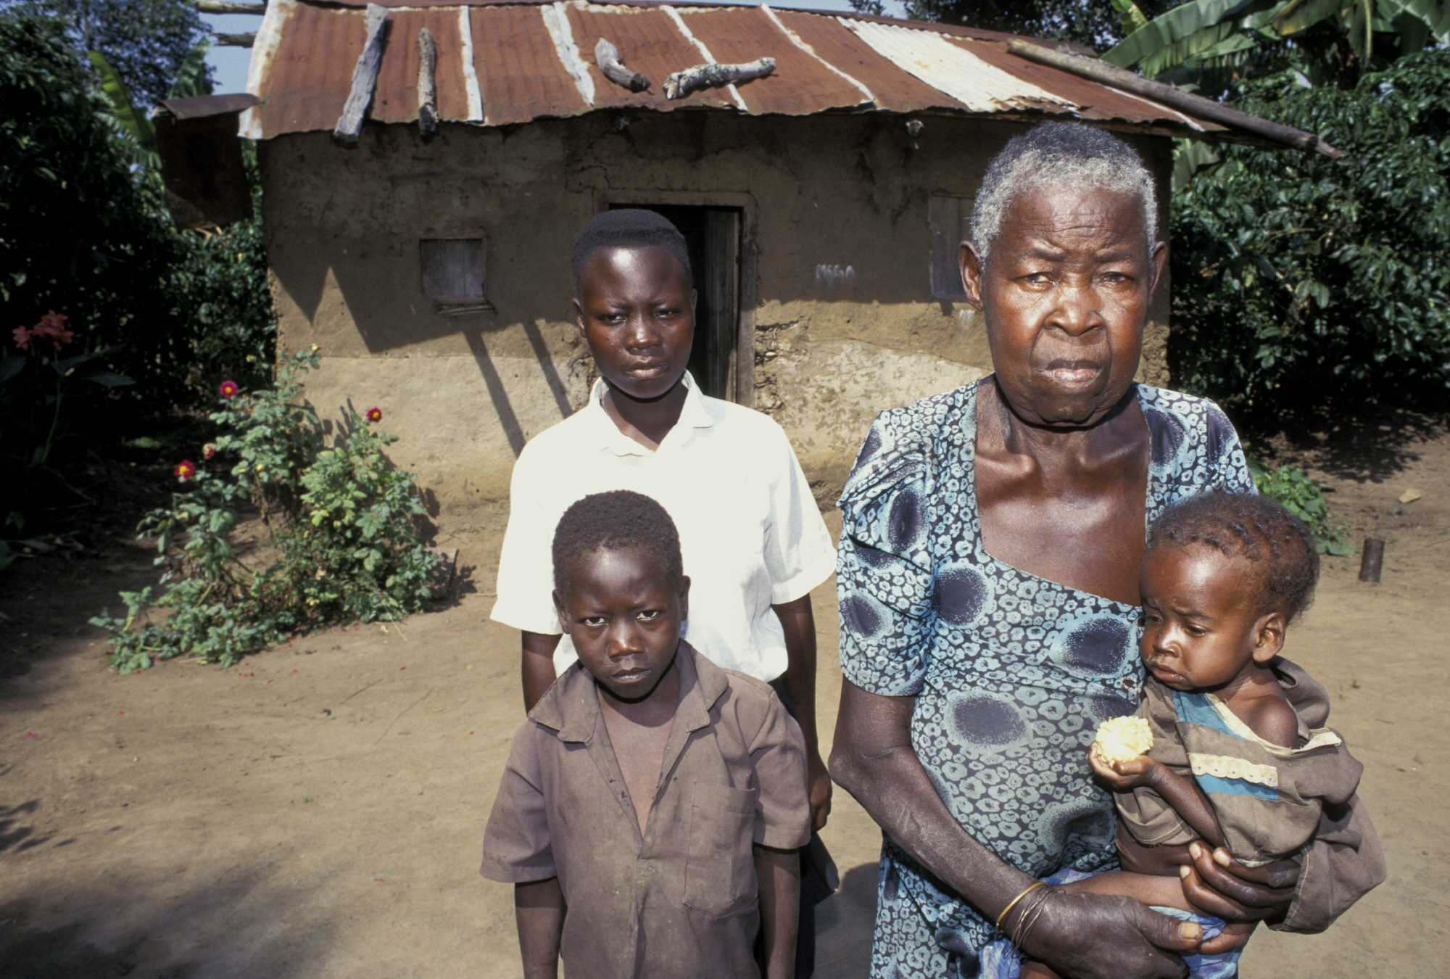

Slide 5
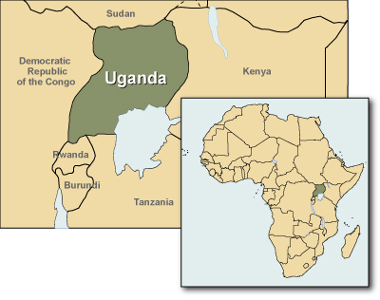
35,873,253 (July 2012 est.)
Life expectancy at birth
  total population: 52.72 years male: 51.66 years female: 53.81 years (2009 estimate)
Highest HIV/AIDS prevalence Childbearing years:15-49
orphaned by HIV/AIDS, who were under the age of 17 in 2001 and 2007 were 1,300,000 and 1,400,000 respectively (UNAIDS & WHO, 2009) .
Notes:
, who’s caring for the orphans: No social supportive services, or gov’tl support

Slide 6
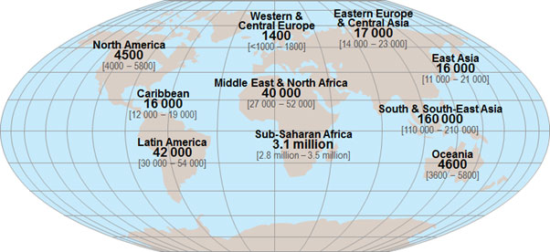
Sub-Saharan Africa (UNAIDS & WHO, 2009) :
  68% of all people living with HIV
  70% of all people newly infected in 2010.
  Nearly 80% (about 4 million) of young people living with HIV globally.
  3000 youth (15-24yrs) die everyday!!

Slide 7
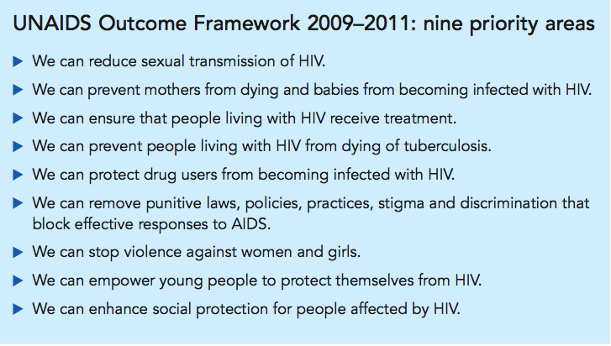
U.N. goal: to halt and reverse the spread of HIV/AIDS by 2015=>$15 billion .
Notes:
At the 2011 High Level Meeting on AIDS, UN Member States
2011 United Nations General Assembly Political Declaration on HIV/AIDS:

Slide 8

=>$22 billion to $24 billion will be needed to achieve the U.N.’s HIV/AIDS targets.
Notes:
universal access to HIV prevention, treatment, care and support.

Slide 9

Notes:
Cohort in despair (birth-elderly)poverty, social insurgencies, HIV, Aging
Global society-increasing diversity
Research and practice culturally competent in understanding the diverse manifestations and symptomatology of MH disorders.

Slide 10


Global Research & Practice Efforts
Notes:
We are a global society

Slide 11
So What ??
The U.S. is becoming more racially and ethnically diverse.
Minorities accounted for 48% of all births in the U.S.
The elderly population also will become more diverse with minorities rising from 20% to 42% of that population group by 2050.
In the recent Census Bureau American Community Survey, 55.4 million people identified themselves as speaking a language other than English at home.

Slide 12
Literature Review
  PubMed, PyschINFO and CINAL
  Older/elderly caregiver OR grandparenting AND psychosocial AND wellbeing AND HIV/AIDS
  Criteria: Ugandan Vs. American/Western studies
  Grandparenting ,health outcomes, African American/minority, Low income populations
  grandparenting under stressful circumstances.

Slide 13

Definitions
Elderly Vs. Older caregivers
Caregiving Vs. Grandparenting
Grandparents Vs. Grandmothers
Age: Mortality rate ~52 (>55 years)
Children (infants-18 years) for at least 6 months

Slide 14
Search results
Ugandan
  Qualitative/descriptive
  impact HIV/AIDS and role of extended family in caring for orphans
  Ambiguity in methodology used
Others:
  International
  African
American
  Quantitative
    Health outcomes, interventional

Slide 15


Search results
American
  Quantitative
    Health outcomes, interventional
American
  Quantitative
    Health outcomes, interventional
Others:
  International
  African
Ugandan
  Qualitative/descriptive
  impact HIV/AIDS and role of extended family in caring for orphans
  Ambiguity in methodology used

Slide 16
Findings
Grand parenting Literature
  Elderly as Caregiver Vs. care receiver
  mid-late 1990’s
  Influencing factors:
    incarceration,
    effects of substance
    mental illnesses
    child abuse, abandonment, unemployment.
  Impact of HIV/AIDS
Notes:
->reviewed American studies

Slide 17
Themes
Cultural and gender expectations
  In sub-Saharan Africa elderly women are traditional caregivers to other family members
  Also African American, Latino, Thai and Chinese grandparents have similar traditional expectations
Notes:
MacNeil, 1996; Ice, Yogo, Heh & Juma, 2010; Ssengozi, 2009; Kamya & Poindexter, 2009; Sudarkasa, 1981; Wilson, 1989

Slide 18
Con’t…
Caregiver Burden
  “an individual’s subjective perception of overload in one or more of four perspectives: physical, psychological, social, and financial.” (Chou, 2000).
Physical Burden
  Responsibilities: Caring for the ill; tasks inside and outside the home such as farming and cooking->feelings of chronic fatigue->physiologic complications
Notes:
overwhelming number of negative impacts of this role on the health and well-being of the elderly

Slide 19
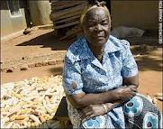
Notes:
Picture speaks volumes
Labor of love

Slide 20
Con’t…
Financial Burden
  60% of caregiving grandparents were found to be more likely to report incomes below poverty level in the United States.
  Uganda: lack of education, and financial resources for basic needs for food, medication, clothing, beds, shelter, and school fees to maintain a house hold

Slide 21
Con’t…
Psychological Burden
  Emotional stress, burnout, fatigue; anger, resentment, mental weariness and isolation
Social Burden
  Increased stigma, isolation and shame among caregivers
  Other social issues: lack of supportive resources e.g. access to care (counseling, treatment), inadequate social infrastructure
Notes:
----- Meeting Notes (2/19/13 09:42) -----
deeper-sitting mental health implications

Slide 22
Coping Mechanisms
Spirituality
  importance of God as the source of strength and hope throughout the process of caring for their ill adult children
  formal religion or non-religious intangible elements as is the case in most rural parts of Uganda
Notes:
(Goodman & Rao 2007; Winston, 2003; Caliandro & Hughes, 1998, Kamya & Poindexter,
2009 Winston, 2003

Slide 23
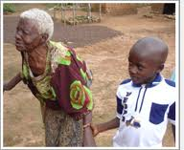
Other..
  Reciprocity; small income-generating projects; charity…

Slide 24

Gaps?
Lack of longitudinal/mixed methods studies
Grandfathers limited
Health outcomes: psychosocial/mental
Rigorous qualitative

Slide 25
Purpose of the Study
The purpose of this grounded theory study is to seek understanding of the experiences and mental health of 55-years and older Ugandan grandparents who provide primary care for their HIV/AIDS infected or other chronically ill grandchildren.

Slide 26
Specific Aims
To explore the range of factors that influence the experience of these older caregivers.
To analyze caregivers’ perceptions of the outcomes of their decision to care for their grandchildren, including impact on their health, quality of life, and relationship satisfaction with significant others.
Explore the prevalence of mental health symptoms, especially depression symptoms in this population.

Slide 27
Methods
Method
  Grounded Theory (Strauss & Corbin).
  Underpinned by Symbolic Interactionism.
  Theory-generating
Design
  Semi-structured qualitative interviews
  Participant observation
  Theoretical and snowball sampling techniques
  Age: 55 years and older, Luganda-speaking, Ugandan grandparents.
  20 total sample or until theoretical saturation
Notes:
>55 years:
World Health organization [WHO], childbearing years of women in Uganda =15-49,
while the life expectancy for women averages at 52 years
Infected/Affected-either one or both and why

Slide 28
Theories
Family Adjustment and Adaptation Response theory (FAAR)
Beck’s Cognitive Theory (BCT)

Slide 29
Family Adjustment and Adaptation Response theory (FAAR)
  Origin: Hill’s (1949, 1958) family stress theory -ABCX framework; separation and reunion in Vietnam War
  McCubbin and Patterson (1983): Double ABCX - included the post-crisis phase =>FAAR

Slide 30
Con’t…
post-crisis process:
  Family Demands: Pile-up (aA Factor): Pre + Current demands
  Family Adaptive Resources (bB Factor): re-arrange, regroup and redistribute existing resources
  Family Definition and Meaning (cC Factor): pre-coping stage-reevaluates of new meaning
  Family Adaptive Coping: Interaction of Resources, Perception, and Behavior: acceptance and coping phase
  Family Adaptation Balancing (xX Factor): bonadaptation or maladaption

Slide 31
Beck’s Cognitive Theory (BCT)
Originally developed by Beck (1967)
Cognitive Triad in Depression :
  Negative view of the world
  Negative view of self
  Negative view of future
Cognitive distortions, affective, physical and motivational symptoms of depression
Other Mechanisms: Biological, Cognitive/Psychological and Environmental/Social
Notes:
Social process and meaning in symbolic interractionism

Slide 32
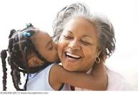
Pilot Study:
Inclusion Criteria:
♥ Grandparents (55 years/older)
Male or female
English-speaking
♥ African American
Caregivers to one or more grandchildren for at least six months.
To date: Data collection and analysis.

Slide 33
Conclusion
  …Yet in the face of severe hardship, these […]grandmothers coped through concrete activities to nurture and raise the grandchildren, viewing their challenges through a lens of spirituality and loving and rejoicing in their grandchildren. They demonstrated hope, wisdom, and generosity. Although we wish to honor this strength, we are reluctant to call this ‘‘resilience’’ out of a fear that focusing on their coping will serve to excuse the world’s neglect or apathy. (Kamya & Poindexter, 2009)
Notes:
Elderly->Respectable social status distorted.
It is a social justice that attention is paid to this population

Slide 34
References
Chou, K. R. (2000). Caregiver burden: A concept analysis. Journal of Pediatric Nursing, 15(6), 398-407.
Caliandro, G., & Hughes, C. (1998). The experience of being a grandmother who is the primary caregiver for her HIV-positive grandchild. Nursing Research, 47(2), 107-113.
del Bene, S.B. (2010). African American Grandmothers Raising Grandchildren: A Phenomenological Perspective of Marginalized Women. Journal of Gerontological Nursing, 36(8), 32-40.
Fuller-Thomson, E., Minkler, M., & Driver, D. (1997). A profile of grandparents raising grandchildren in the United States. The Gerontological Society of America, 37, 406-411.
Joint United Nations Programme on HIV/AIDS (UNAIDS) and World Health Organization (WHO) (2009). Report on the global AIDS Epidemic, 21-36. Geneva: WHO Library Cataloguing.
Kamya, H., & Poindexter, C.C. (2009): ‘Mama Jaja’: The Stress and Strengths of HIV-Affected Ugandan Grandmothers. Social Work in Public Health, 24:1, 4-21

Slide 35
Con’t…
Kruger, A., LekalakalaMokgela, S. E., & Wentzel-Viljoen, E. (2011). Rural and Urban Older African Caregivers Coping With HIV/AIDS are Nutritionally Compromised. Journal of Nutrition in Gerontology and Geriatrics, 30:3, 274-290
Minkler, M., Fuller-Thompson, E., Miller, D., & Driver, D. (1997). Depression in grandparents raising grandchildren: Results of a national longitudinal study. Archives of Family Medicine, 6:5, 445-452.
Musil C.M. (1998) Health, stress, coping, and social support in grandmother caregivers. Health Care for Women International 19, 441–455.
Musil, C. M., & Ahmad, M. (2002). Health of grandmothers: A comparison by caregiver status. Journal of Aging and Health, 14(1), 96-121.
Musil, C.M., Warner, C.B., Zauszniewski, J., Jeanblanc, A. B., & Kercher, K. (2006). Grandmothers, Caregiving, and Family Functioning. Journal of Gerontology. 61:2, 89–98
Musil, Warner, Zauszniewski, Wykle & Standing, (2009). Grandmother Caregiving, Family Stress and Strain, and Depressive Symptoms Western Journal of Nursing Research 31: 389
Musil, Gordon, Warner, Zauszniewski, Standing, and Wykle, (2011). Grandmothers and Caregiving to Grandchildren: Continuity, Change, and Outcomes Over 24 Months. Gerontologist 51: 86-100.

Slide 36
Con’t…
Ruiz, D. (2002). The increase in incarcerations among women and its impact on the grandmother caregiver: Some racial considerations. Journal of Sociology and Social Welfare, 29, 179-197.
Seeley, J. & Kajura, E., Bachengana, C., Okongo, M., Wagner, U. & Mulder D. (1993): The extended family and support for people with AIDS in a rural population in south west Uganda: A safety net with holes? AIDS Care, 5:1: 117
Ssengonzi, R. (2009). The impact of HIV/AIDS on the living arrangements and well being of elderly caregivers in rural Uganda. AIDS Care, 21:3, 309-314.
Vithayachockitikhun, N. 2006. Family caregiving of persons living with HIV/AIDS in Thailand: Caregiver burden, an outcome measure. International Journal of Nursing Practice 12, 123–128
Winston, C. A. (2003). African American Grandmothers Parenting AIDS Orphans: Concomitant Grief and Loss. American Journal of Orthopsychiatry,1, 91-100.

Slide 37

End….

